Slide 1

VHDL (Introduction)
Winter 1400 (Computer Aided Design)
Meisam Abdollahi
School of Computer Engineering
Iran University of Science and Technology
meisam.abdolahi@ut.ac.ir

Slide 2
Outline
Types of HDL
VHDL vs. Verilog
VHDL (Introduction)

Slide 3
Hardware Description Language
A hardware description language (HDL) is a specialized computer language used to describe the structure and behavior of digital systems.
A hardware description language looks much like a programming language such as C.
The main difference with software programming languages is the nature of HDL is parallel; while the nature of software languages is sequential
It is a textual description consisting of expressions, statements and control structures
Most commercial designs built using HDLs

Slide 4
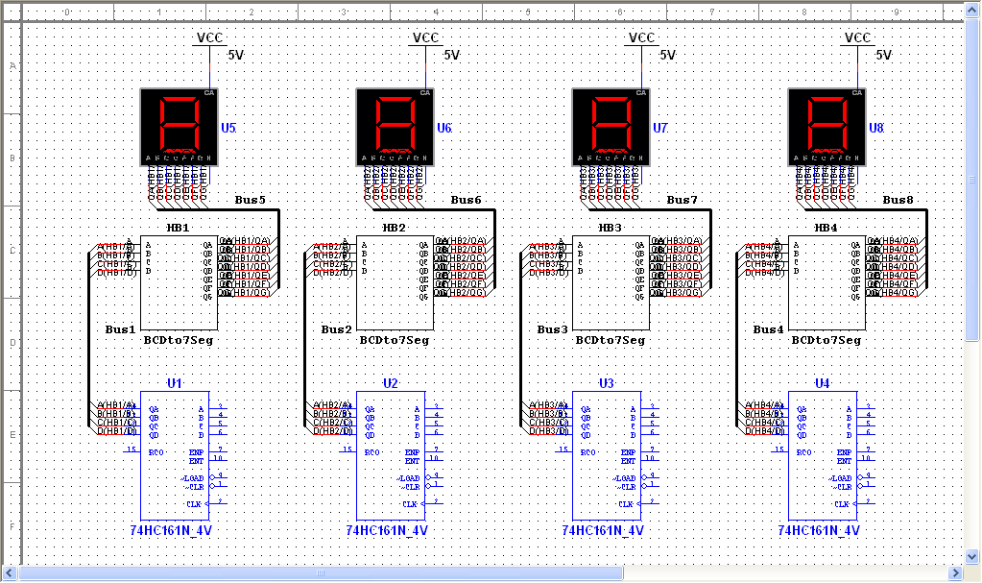
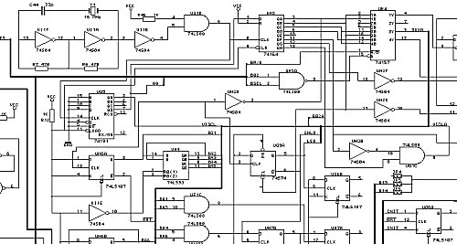
HDL vs. Schematic
Schematic’s advantages
Useful for small projects
Easy to learn and design
Schematic’s disadvantages
difficult to manage when complexity grows (million gates ASICs-FPGAs)
difficult to maintain for a long lifetime

Slide 5
Types of HDL languages
Two leading HDLs:
Verilog
Developed in 1984 by Gateway Design Automation
Became an IEEE standard (1364) in 1995
VHDL
Developed in 1981 by the Department of Defense
Became an IEEE standard (1076) in 1987
Other HDL languages
GEZEL
SystemC
Ruby
JHDL
etc.

Slide 6
VHDL vs. Verilog
Verilog is based on C, while VHDL is based on Pascal and Ada.
Unlike Verilog, VHDL is strongly typed.
Unlike VHDL, Verilog is case sensitive. Verilog is easier to learn compared to VHDL.
Verilog has very simple data types, while VHDL allows users to create more complex data types
VHDL more popular with European companies, Verilog more popular with US companies.

Slide 7
VHDL vs. Verilog
High level constructs
VHDL:
There are more constructs and features for high-level modeling in VHDL than there are in Verilog.
Abstract data types can be used along with the following statements:
package statements for model reuse,
configuration statements for configuring design structure,
generate statements for replicating structure,
generic statements for generic models that can be individually characterized, for example, bit width.
Verilog:
there is no equivalent to the high-level VHDL modeling statements in Verilog

Slide 8
VHDL vs. Verilog
Libraries
VHDL:
A library is a store for compiled entities, architectures, packages and configurations.
Useful for managing multiple design projects.
Verilog:
There is no concept of a library in Verilog. This is due to it's origins as an interpretive language.

Slide 9
VHDL vs. Verilog
Low level constructs
VHDL
Simple two input logical operators are built into the language, they are: NOT, AND, OR, NAND, NOR, XOR and XNOR.
Any timing must be separately specified using the after clause.
Verilog
The Verilog language was originally developed with gate level modeling in mind, and so has very good
Constructs for modeling at this level and for modeling the cell primitives of ASIC and FPGA libraries.
Examples include User Defined Primitives (UDP), truth tables and the specify block for specifying timing delays across a module.

Slide 10
VHDL vs. Verilog
VHDL
Example [Binary up counter]
process (clock)
begin
if clock='1' and clock'event then
counter <= counter + 1;
end if;
end process;
Verilog
reg [upper:0] counter;
always @(posedge clock)
counter <= counter + 1;

Slide 11
VHDL vs. Verilog
Verilog and VHDL are equivalent for RTL modeling (code that will be synthesized).
For high level behavioral modeling, VHDL is better
Verilog does not have ability to define new data types
Other missing features for high level modeling
Verilog has built-in gate level and transistor level primitives
Verilog much better than VHDL at below the RTL level.
The choice of which to use is not therefore based solely on technical capability but on:
Personal preferences
EDA (Electronic design automation) tool availability
Commercial, business and marketing issues
Bottom Line: You should know both!!!!!

Slide 12
VHDL

Slide 13
Introduction to VHDL
VHDL: VHSIC Hardware Description Language
VHSIC: Very High Speed Integrated Circuit
History of VHDL
1980: initiated by US army (Pentagon) to describe and to document of electronic systems
1985: 7.2 version of VHDL by IBM, Intermetrics and Texas Instruments
1986: All rights transfer to IEEE
1987: publication of IEEE standard
1987: first IEEE version – IEEE1067-1987
1993: Revised Standard- IEEE1076-1993 (vhdl-93)

Slide 14
Introduction to VHDL
How is VHDL used?
For design specification
For simulation
For documentation
For implementation
For test & verification
As an alternative to schematic design
Why VHDL?
Achieve Maximum Reliability With
Minimum cost
Minimum development time
Allow Automatic Synthesis of Design into Hardware

Slide 15
Introduction to VHDL
C:
Procedural (method) programming languages
Typically describe methods for computing a math function or manipulation of data (e.g., sorting, matrix computing)
A program is a recipe or a sequence of steps for how to perform a computation or manipulate data.
VHDL:
A language to describe digital systems.
Purposes: simulation and synthesis of digital systems.

Slide 16
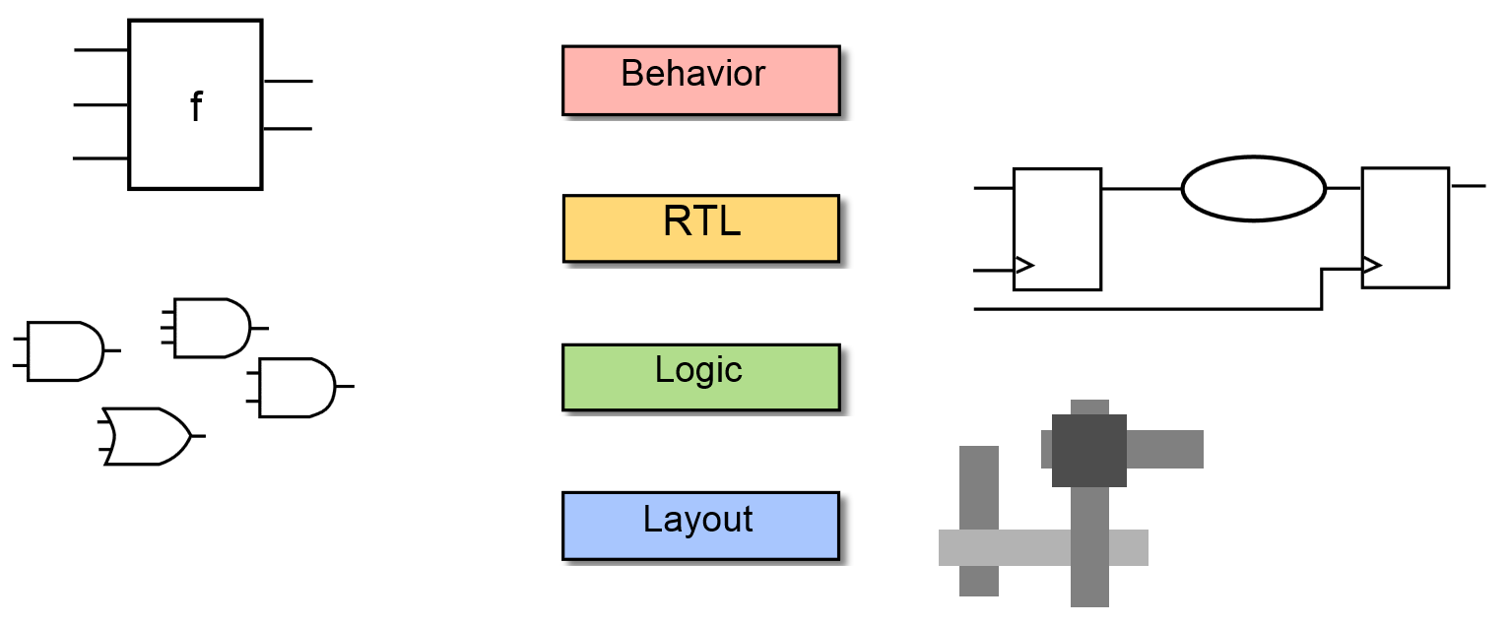
VHDL: Abstraction Levels (I)

Slide 17
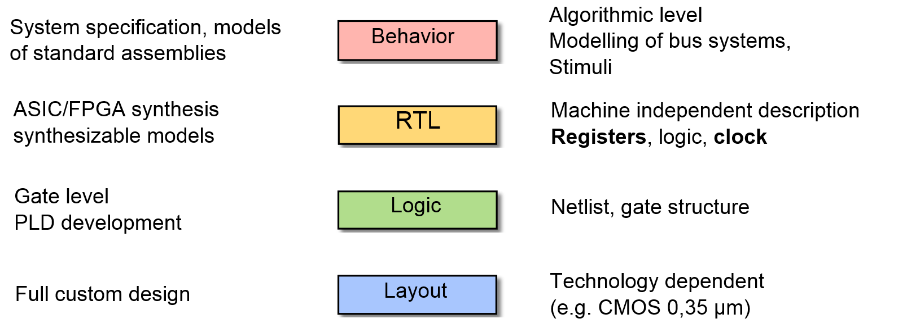
VHDL: Abstraction Levels (II)

Slide 18
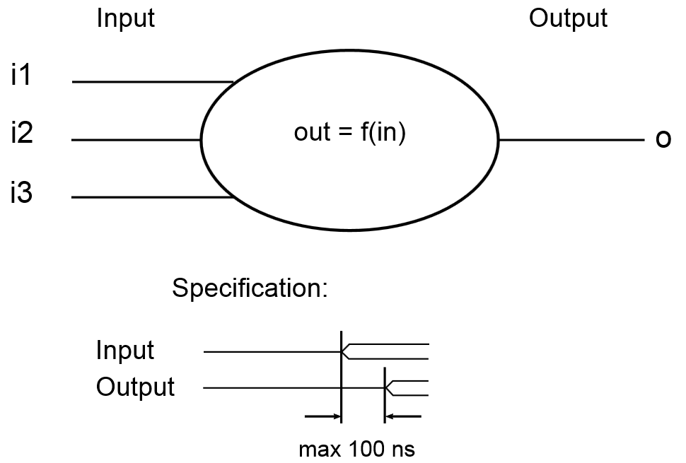
Behavioral Description in VHDL
This level describes a system by concurrent algorithms (Behavioral).
Each algorithm itself is sequential (consists of a set of instructions that are executed one after the other.)
Functions, procedures are the main elements. There is no regard to the structural realization of the design.
o <= transport i1 + i2 * i3 after 100 ns;

Slide 19
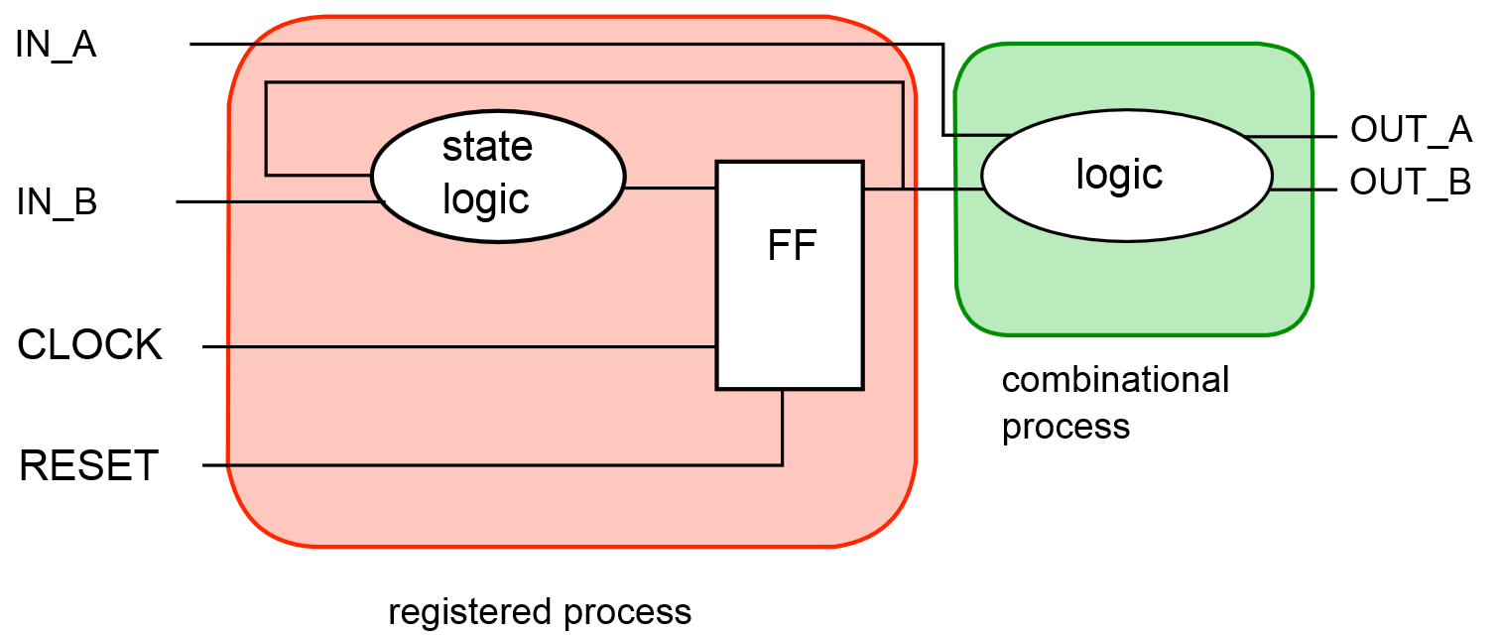
RT Level in VHDL (Data flow)
Specifying the characteristics of a circuit by operations and the transfer of data between the registers.
An explicit clock is used.
RTL design contains exact timing possibility,
Operations are scheduled to occur at certain times
Modern definition of a RTL code is "Any code that is synthesizable is called RTL code".

Slide 20
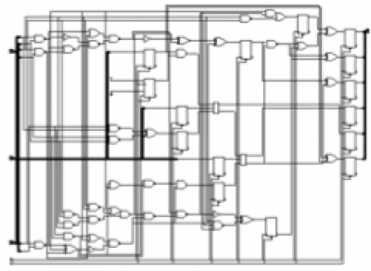
Gate-level in VHDL (Structural)
U86 : ND2 port map (A => n192, B=> n191, Z=> n188);
U87 : ND2 port map (A => I3_2, B=> I2_0, Z => n175);
U88 : ND2 port map (A => I2_2, B=> I3_0, Z => n173);
U89 : NR2 port map (A => mul_36_PROD_not_0, B=> n174, Z => n185);
U90 : EN port map (A => n181, B=> n182, Z => n180);
U91 : ND2 port map (A => I3_2, B=> I2_1, Z => n181);
U92 : ND2 port map (A => I2_2, B=> I3_1, Z => n182);
U93 : IVP port map (A => n180, Z => n192);
U94 : A06 port map (A => n173, B=> n174, C => n175, Z => n172);
U95 : NR2 port map (A => n174, B=> n173, Z => n176);
U96 : ND2 port map (A => I3_1, B=> I2_1, Z => n174);
U97 : EN port map (A => n183, B=> n178, Z => product64_4);
U98 : ND3 port map (A => I2_2, B=> I3_2, C => n174, Z => n183);
A gate level description consists of a network of gates and registers instanced from a technology library

Slide 21
Let’s start VHDL

Slide 22
Let’s Start Simple
The structure of a Full Adder
In1
s1
sum
In2
s2
s3
c_out
c_in

Slide 23
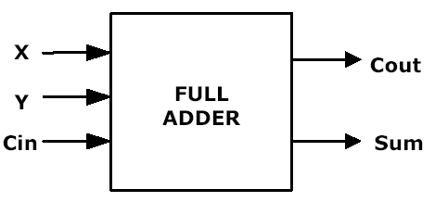
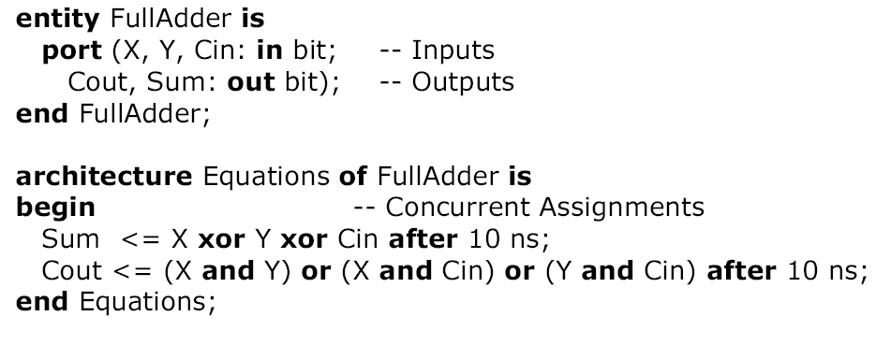
Entity-Architecture Pair
1- in
2- out
3- inout
4- buffer
entity name
port names
port mode (direction)
port type
punctuation
reserved words

Slide 24
Entity Declarations
The entity describes the interface to the outside world.
It specifies the number of ports, the direction of the ports, and the type of the ports
The interface signals are listed in the PORT clause
In this respect, the entity is akin to the schematic symbol for the component
Entity is roughly equivalent to a function definition in C
Notes:
25

Slide 25
Entity Example
x
cout
y
FULL
Adder
sum
cin
ENTITY full_adder IS
PORT( x, y, cin : IN BIT;
cout, sum : OUT BIT);
END full_adder;

Slide 26
Entity Declarations Port Clause
Three parts of the PORT clause
Name
Mode
Data type
PORT (signal_name : mode data_type);
PORT ( input : IN BIT_VECTOR(3 DOWNTO 0);
ready, output : OUT BIT );
Notes:
26

Slide 27
Entity Declarations
The Port Mode of the interface describes the direction in which data travels with respect to the Component
Four Port Modes
In (Input port): A variable or a signal can read a value from a port of mode in, but is not allowed to assign a value to it.
Out (Output port): It is allowed to make signal assignments to a port of the mode out, but it is not legal to read from it.
Inout (bidirectional port): Both assignments to such a port and reading from it are allowed.
Buffer: output port with read capability. It differs from inout in that it can be updated by at most one source, whereas inout can be updated by zero or more sources.
Notes:
27

Slide 28
Entity: Example
8
inputs
3
Mux8to1
output
Select_s
entity Mux8to1 is port ( Inputs : in Std_Logic_Vector(7 downto 0); Select_s : in Std_Logic_Vector(2 downto 0); Output : out Std_Logic ); end Mux8to1;

Slide 29
Architecture Body
Describes the operation of the component, Not just its interface
It describes the underlying functionality of the entity and contains the statements that model the behavior of the entity.
More than one architecture (and usually) is associated with each entity
Each architecture suited to different type of modeling
e.g., a behavioral arch., a structural arch, a RTL arch.
Notes:
29

Slide 30
Architecture Body (II)
Consists of Two Parts
1. Declarative part -- includes necessary declarations, e.g.
Type declarations
Signal declarations
Component declarations
Subprogram declarations
2. Statement part -- includes statements that describe organization and/or functional operation of component, e.g.
Concurrent signal assignment statements
Process statements
Component instantiation statements

Slide 31
Architecture Body, e.g.
The architecture name
ARCHITECTURE structural OF full_adder IS
-- architecture declarative part
SIGNAL xor_res : BIT ;
-- architecture statement part
BEGIN
cout <= (x AND y) OR (x AND cin) OR (y AND cin) ;
xor_res <= x XOR y ;
sum <= xor_res XOR cin;
END structural ;
Declarative Part
Statement Part
The Entity name
End of architecture

Slide 32
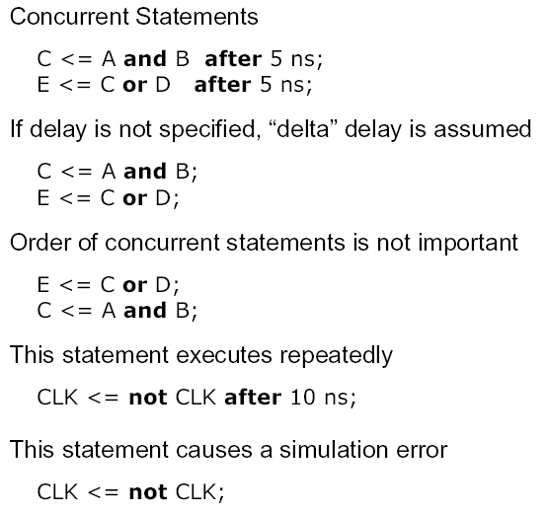
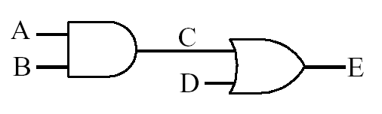
VHDL Description of Combinational Networks

Slide 33
Lexical Elements of VHDL
Comments
two dashes to end of line is a comment, e.g.,
--this is a comment
Basic Identifiers
Can Only Use
alphabetic letters ( A-Z, a-z ), or
Decimal digits ( 0-9 ), or
Underline character ( _ )
Not case sensitive
( LastValue = = lAsTvALue)
Reserved Words
Do not use as identifiers
Special Symbols
Single characters
& ‘ ( ) * + , - . / : ; < = > |
Double characters (no intervening space)
=> ** := /= >= <= <>
Copyright  1997, KJH

Slide 34
Identifiers
Identifiers are used to name items in a VHDL model
may only contain alphabetic letters (‘A’ to ‘Z’ and ‘a’ to ‘z’), decimal digits (‘0’ to ‘9’) and the underline character (‘_’);
must start with an alphabetic letter;
may not end with an underline character; and
may not include two successive underline characters.

Slide 35
Examples of identifiers
Some examples of valid basic identifiers are
A
X0
counter
Next_Value
generate_read_cycle
Some examples of invalid basic identifiers are
last@value
5bit_counter
_A0
A0_
clock__pulse
–– contains an illegal character for an identifier
–– starts with a nonalphabetic character
–– starts with an underline
–– ends with an underline
–– two successive underlines

Slide 36
Reserved Words
we cannot use reserved words as identifiers for items we define
Reserved words in VHDL
abs access after alias all and architecture array assert attribute begin block body buffer bus case component configuration constant | disconnect downto else elsif end entity exit file for function generate generic group guarded if impure in inertial inout | is label library linkage literal loop map mod nand new next nor not null of on open or others | out package port postponed procedure process pure range record register reject return rol ror select severity signal shared sla | sli sra srl subtype then to transport type unaffected units until use variable wait when while with xnor xor

Slide 37
Strings
Bit Strings
B for binary ( b”0100_1001” )
O for Octal ( o”76443” )
X for hexadecimal ( x”FFFE_F138” )

